Slide 1
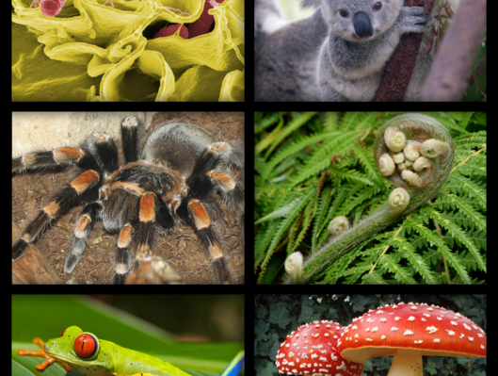
Classification & the Six Kingdoms Note Book

Slide 2
Color and label each domain and kingdom on the front and back cover of your booklet.

Slide 3
Write the characteristics of each domain and kingdom on the front and back cover of your booklet.
Archaea are always unicellular prokaryotes that live in extreme environments
Bacteria are always unicellular prokaryotes that live in the same environments as Humans
Protista are always eukaryotic, single celled or multi-celled organisms; some are fungi-like, some are plant-like and some are animal-like
Plantae are always eukaryotic multicellular organisms that are not mobile and almost always photosynthesize
Fungi are always eukaryotic, multicellular or unicellular organisms that are not mobile and always heterotrophic
Animalia are always eukaryotic multicellular organisms that are mobile and always heterotrophic

Slide 4
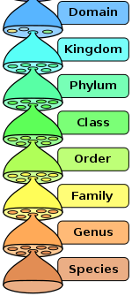
Levels of classification
Every organism can be sorted through the levels of classification
Classification sorts from least specific to most specific (more general to more specific)
Domain is the most general & most inclusive level
species is the most specific & most exclusive level

Slide 5
Levels of classification Page 3
TAXON
Least Specific
Domain
Most General
Kingdom
Phylum
Class
Order
Family
Genus
Most Specific
species
Least General

Slide 6
Levels of Classification Page 3
Make a mnemonic sentence to help you remember the order of the levels of classification (Domain → species)
Ex:
Did King Philip Come Over For Good spaghetti?

Slide 7
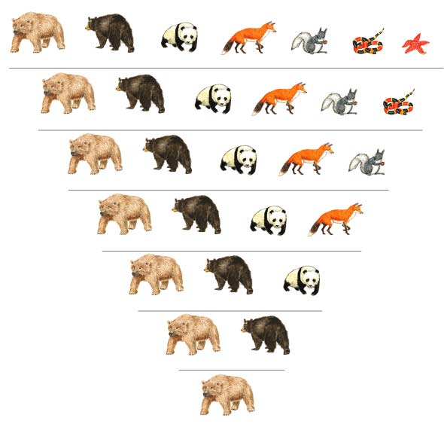
Grizzly bear
Black bear
Giant panda
Abert squirrel
Coral snake
KINGDOM Animalia
Red fox
Sea star
PHYLUM Chordata
CLASS Mammalia
ORDER Carnivora
FAMILY Ursidae
GENUS Ursus
SPECIES arctos

Slide 8
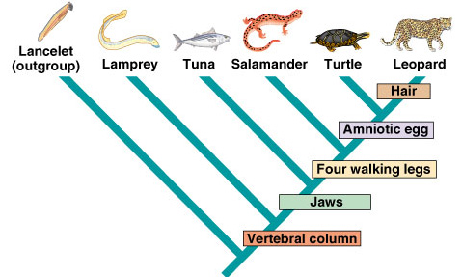
Reading a Cladogram Page 4
Cladograms show the acquisition of traits (Shows traits Not dates)
This means they show the sequence of adaptations
Everything that comes after a trait/adaptation will have that trait/adaptation
Ex: Lancelets and Lampreys evolved before the jaw adaptation, so they DO NOT have jaws

Slide 9
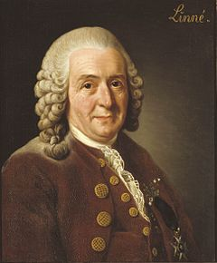
Binomial nomenclature Page 5
Carolus Linnaeus (1707-1778)
Botanist
Wanted a better way to classify organisms other than by common name.
Why would using common names of organisms be problematic for scientists?

Slide 10
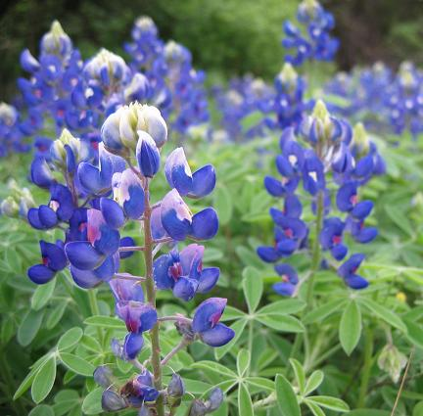
Binomial nomenclature Page 5
Common names cause confusion if the names differ by location
What do you call these flowers?
In Texas we call them
Texas blue bonnets
In other places they are called
Lupins

Slide 11
Binomial nomenclature Page 5
Linnaeus created Binomial Nomenclature to make it easier to discuss the same things from region to region
It is made up of the last two levels of classification… Genus and species
3 Rules for scientific naming…
Includes the Genus name and the species name
Genus is ALWAYS capitalized, species is NEVER capitalized
Underline each word seperately, or type in italics
Lupinus texensis

Slide 12
Binomial nomenclature Page 5
List at least 4 of these examples:
Human – Homo sapien
Chimpanzee – Pan trogolodyte
Dog – Canis familiaris
California Redwood – Sequoia sempervirens
Lynx – Lynx rufus
Bobcat – Lynx canadensis
“E. coli” bacteria – Escherichia coli

Slide 13
Prokaryotes
Domain Archaea | Domain Bacteria
Examples: | Examples:
6 | 7
Bacterial Shapes and Grouping – Draw the 3 shapes and the groupings from the next two slides
Domain Eukarya

Slide 14
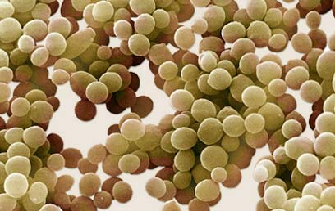
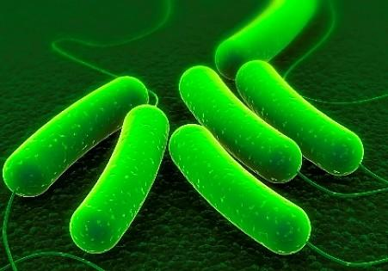
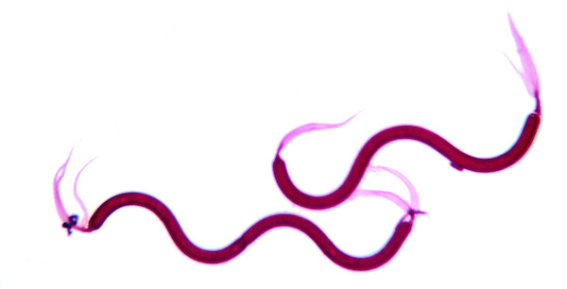
Prokaryotic Shapes
In the box on page 6-side
Coccus – round or spherical
Bacillus – rod shaped
Spirillum – spiral shaped

Slide 15
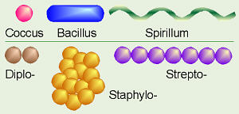
Bacterial Grouping
In the box on page 7-side
Strepto- (chains)
Staphylo- (clusters like grapes)
Diplo- (pairs)

Slide 16
Domain Archaea Page 6
Examples:
All organisms in this domain are ALWAYS Prokaryotic therefore unicellular
Contains 1 Kingdom – Archaeabacteria
Thermophiles, Halophiles and Methanogens

Slide 17
Domain Bacteria Page 7
Examples:
All organisms in this domain are Prokaryotic
therefore ALWAYS unicellular
Contains 1 Kingdom – Eubacteria (true bacteria)

Slide 18
Domain Eukarya (This spans the bottom of pages 6-7 below the solid line)
All organisms in this domain are Eukaryotic
Remember: all cells here must have…
Membrane Bound Organelles
Contains 4 kingdoms
Protista, Fungi,
Plantae and Animalia
Nucleus, Golgi, lysosome, mitochondria, chloroplast etc.
Some multicellular some unicellular.
ALWAYS multicellular.

Slide 19
Breaking down the Domains (not in book)
Scientists used to view the world much differently in the past
In the 1950s scientists thought all bacteria were the same and called them Monera

Slide 20
Breaking down the Kingdoms (not in book)
Lets look at the way we define kingdoms today (DO NOT copy the definitions yet)
Classification of Living Things
DOMAIN
KINGDOM
CELL TYPE
CELL STRUCTURES
NUMBER OF CELLS
MODE OF NUTRITION
EXAMPLES
Archaea
Archaebacteria
Prokaryote
Cell walls without peptidoglycan
Unicellular
Autotroph or heterotroph
Methanogens, halophiles
Protista
Eukaryote
Cell walls of cellulose in some; some have chloroplasts
Most unicellular; some colonial; some multicellular
Autotroph or heterotroph
Amoeba, Paramecium, slime molds, giant kelp
Fungi
Eukaryote
Cell walls of chitin
Most multicellular; some unicellular
Heterotroph
Mushrooms, yeasts
Bacteria
Eubacteria
Prokaryote
Cell walls with peptidoglycan
Unicellular
Autotroph or heterotroph
Streptococcus, Escherichia coli
Eukarya
Plantae
Eukaryote
Cell walls of cellulose; chloroplasts
Multicellular
Autotroph
Mosses, ferns, flowering plants
Animalia
Eukaryote
No cell walls or chloroplasts
Multicellular
Heterotroph
Sponges, worms, insects, fishes, mammals

Slide 21
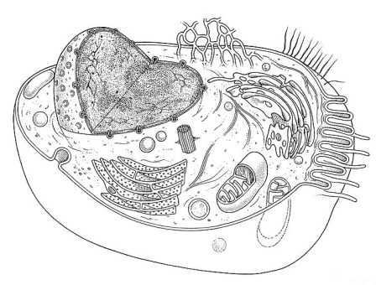
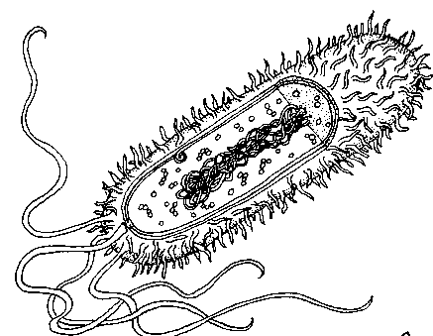
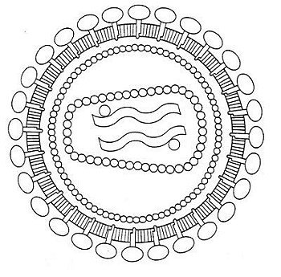
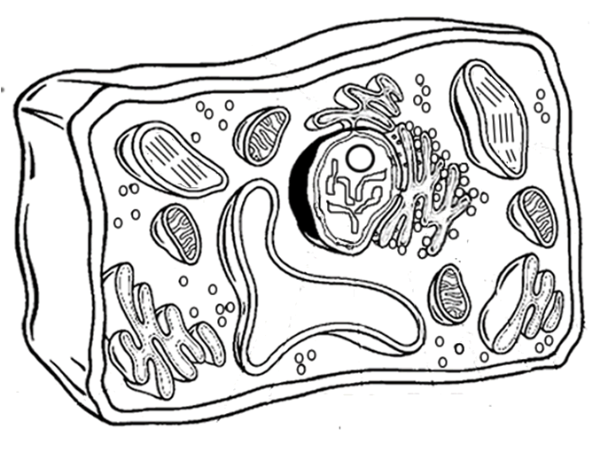
Cell and Virus Characteristics
Animal cells NEVER have a cell wall
They are always eukaryotic. There are numerous variations. They are always part of multicellular organism
Bacterial cells are NEVER multicellular and they are always prokaryotic, they sometimes have flagella, cillia or pili. They do have a cell wall.
They have NO nucleus
Animal Cell
Bacterial Cell
Plant cells always have a cell wall. There are numerous variations. They are always part of multicellular organism
Viruses are NOT CELLULAR
They are comprised of genetic material and a protein coat
Plant Cell
Virus

Slide 22
The Six Kingdoms Page 9 (You will come back to this page)
Kingdom | General Description
Archaebactria
Eubacteria
Protista
Fungi
Plantae
Animalia

Slide 23
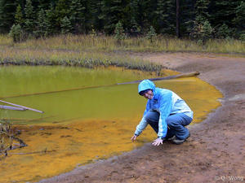
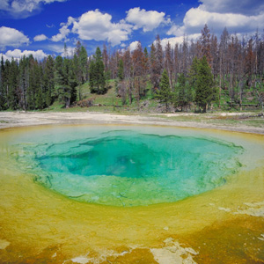
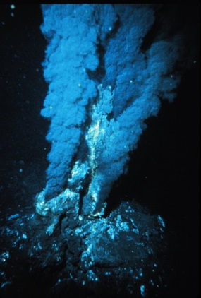
Kingdom Archaebacteria Page 10
ALWAYS Prokaryote
Live in extreme environments
Most DO NOT use oxygen
Their cell walls DO NOT have the protein Pepti-do-glycan
ALWAYS Unicellular
Some autotrophic, some heterotrophic
Ex:
Thermophiles – live in extreme temperatures (hot & cold)
Halophiles – live in very salty environments
Methanogens – make methane as waste product (why swamp gases and septic tanks smell bad)

Slide 24
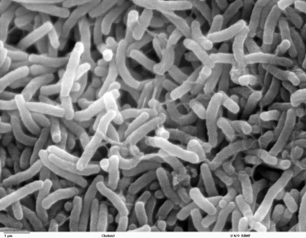
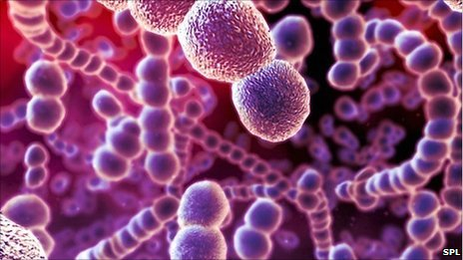
Kingdom Eubacteria Page 11
ALWAYS Prokaryote Unicellular
Essential for the N cycle
Live in same environments as humans
Their cell walls DO have the protein Pepti-do-glycan
Some autotrophic, some heterotrophic
Many are Decomposers
Ex:
E. coli, bacteria that can be helpful or harmful
Streptococcus pneumonia – harmful, causes sickness
Lactobacillus acidophilus – beneficial, found in yogurt

Slide 25
E. coli article (Bottom box page 10)
Play or present NPR article…

Slide 26
Domain Bacteria (Bottom box Page 11)
Harmful
E. coli
Listeria monocytogenes http://www.cnn.com/2015/04/20/health/blue-bell-ice-cream-recall/
Salmonella enterica, Colstridium botulinum (food poisoning)
MRSA (Methicillin-resistant Staphylococcus aureus)
Streptococcus pneumoniae
S. Pyogenes (strep throat)
Propionibacterium acnes (Acne)

Slide 27
Domain Bacteria Page 11 (Middle half examples)
Helpful/ Beneficial
E. coli
Lactobacillus casei, L. bulgaricus, (yogurt)
Colstridium botulinum - Botox
Rhodopseudomonas plaustrus (Denitrifying)
Rhizobium leguminosarium (Nitrogen fixing)

Slide 28
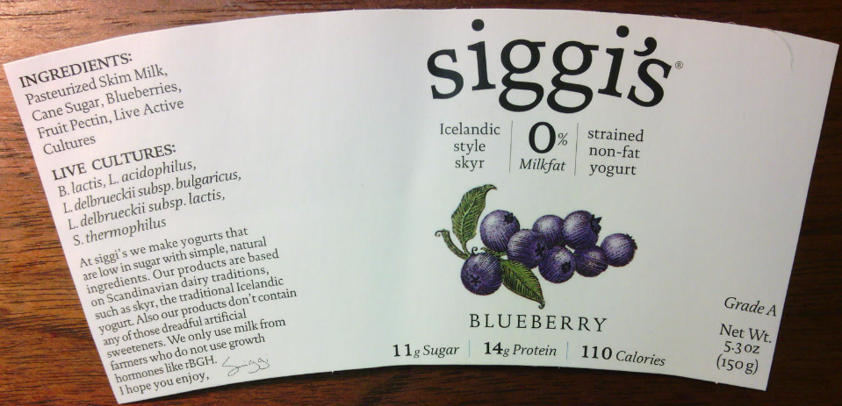

Slide 29
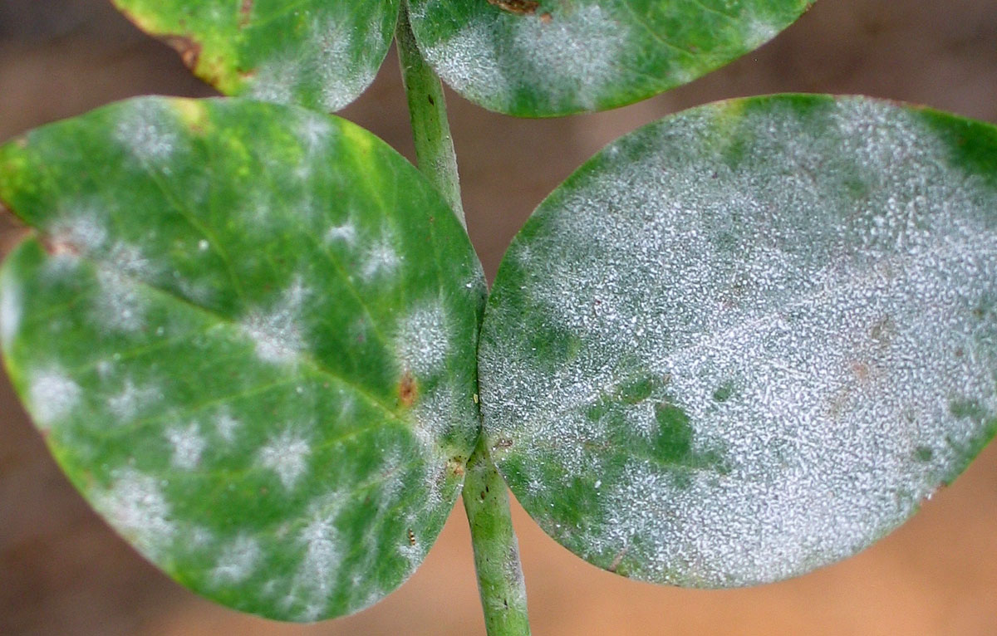
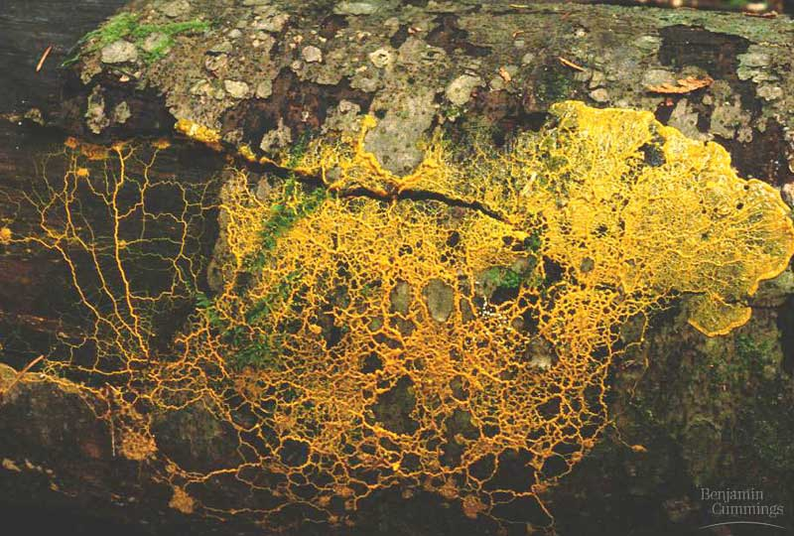
Kingdom Protista: Water Molds (Fungus-like protists) Page 12
Unicellular or colonial groups usually
Cell walls DO NOT have chitin like true Fungi
Some have mobile stage of life cycle
Important Decomposers
Ex:
Slime-mold, powdery mildew

Slide 30
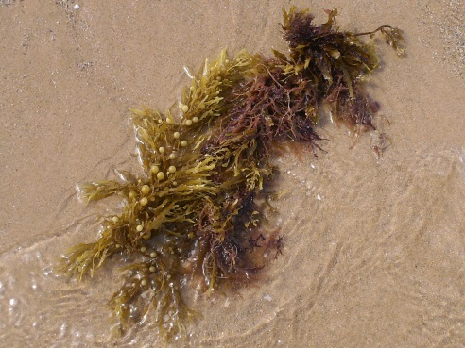
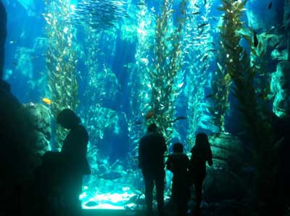
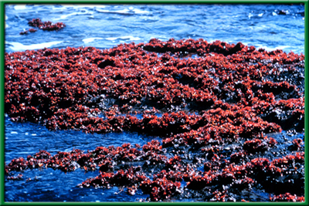
Kingdom Protista: Algae (Plant-like protists) Page 12
Unicellular and colonial
Photosynthetic
DO NOT have roots, stems or leaves
Ex:
Algae, kelp, sea-weed

Slide 31
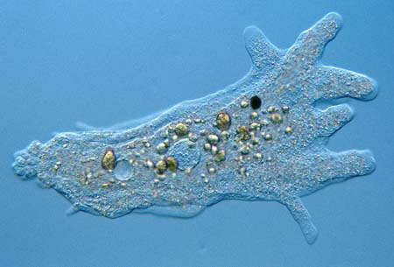
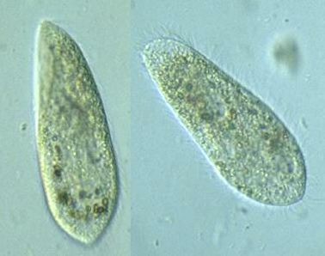
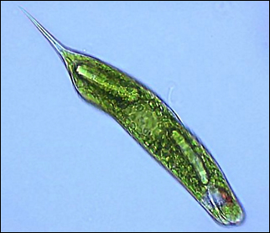
Kingdom Protista: Protozoa (Animal-like protists) Page 13
Eukaryotic
Mostly heterotrophic (some also photosynthesize)
Unicellular
Motile/Mobile (can move)
Ex:
Amoeba, Paramecia, Euglena
Pseudopodia
Cilia
Flagella

Slide 32
Amoeba in motion
Paramecium in motion
Euglena in motion

Slide 33
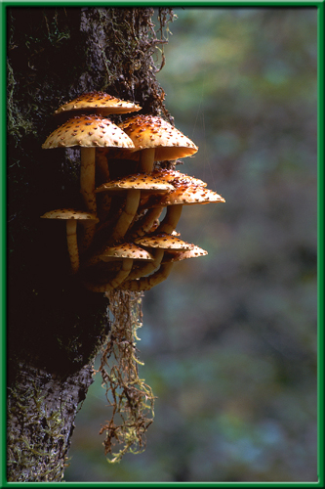
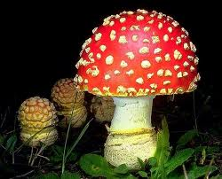
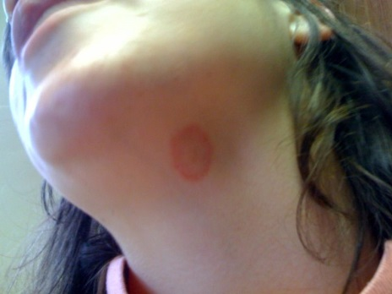
Kingdom Fungi Page 14
Eukaryotic
VERY important decomposers
Saprobes – eat decaying matter
Heterotrophic
Cell Walls made of Chitin
Multicellular and unicellular
EXTRACELLULAR DIGESTION
Ex:
Molds, Mushrooms, Athlete’s Foot, Ring worm

Slide 34
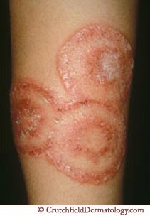
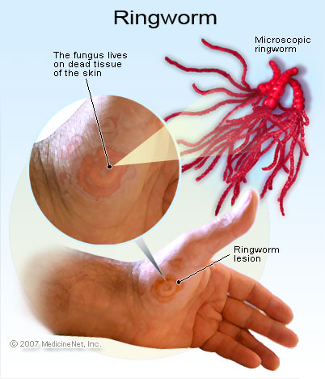
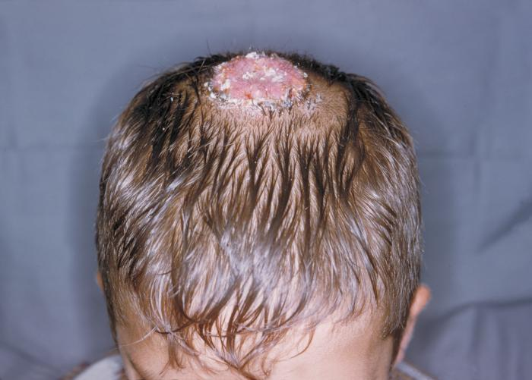
Ringworm

Slide 35
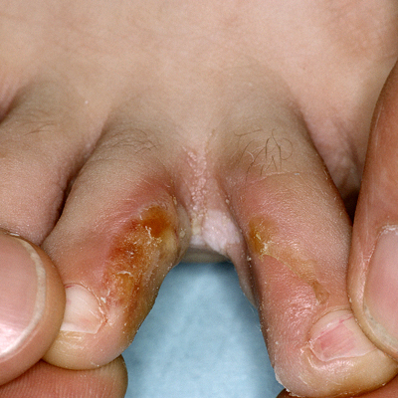
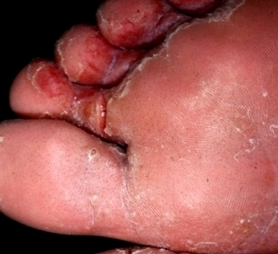
Athletes foot

Slide 36
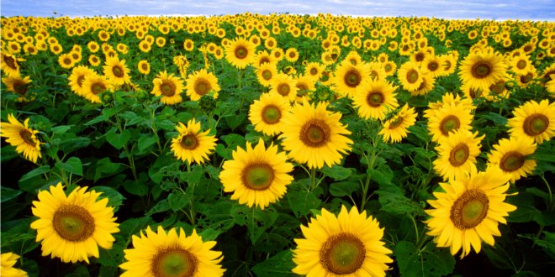
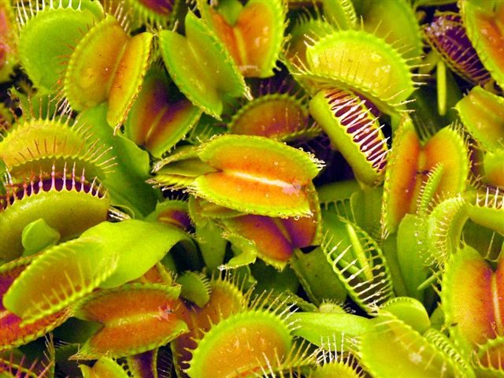
Kingdom Plantae Page 15
Eukaryotic
Multicellular
Photosynthetic
Non-motile (doesn’t move)
Cell walls made of cellulose
Ex:
Mosses, Ferns, Gymnosperms, Angiosperms

Slide 37
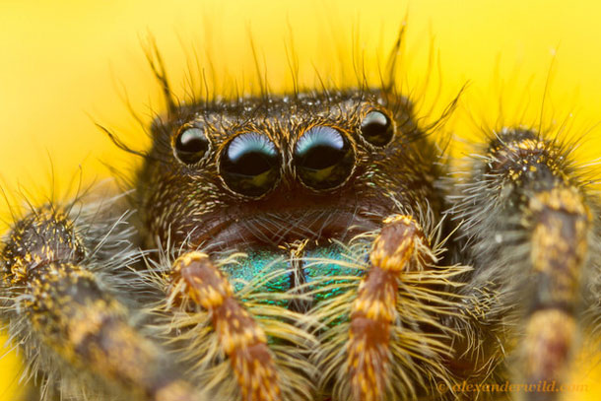
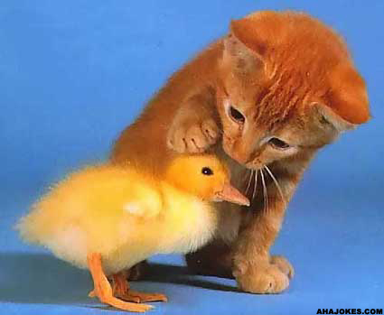
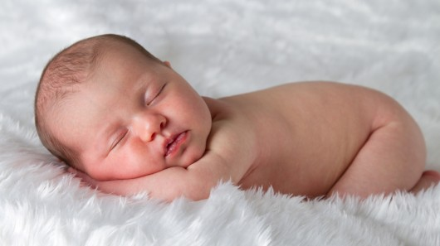
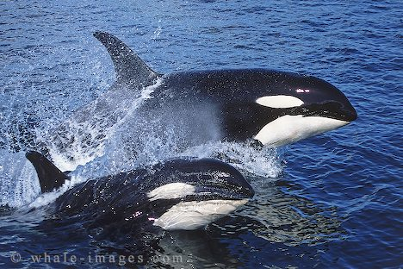
Kingdom Animalia Page 16
Eukaryotic
Multicellular
Heterotrophic
Motile (moves)
Ex:
Humans, spiders, lions, tigers and bears etc.

Slide 38
Major Phyla of the Animal Kingdom Not in book
Phylum | Examples
Porifera | Sea sponges
Cnidaria | Jellies and Medusas
Platyhelminthes | Flat worms (Tapeworms)
Nemotoda | Round worms (Pin worms, heart worms)
Annelida | Segmented worms (Earthworm)
Mollusca | Clams and relatives, Octopi/Squid and relatives
Arthropoda | Shelled (exoskeleton) animals, crabs, spiders, scorpions, insects
Echinodermata | Starfish, sea urchins
Chordata | Animals with a spinal chord (Fish, Amphibians, Reptiles, Birds and Mammals)

Slide 39
REFLECTION
Go back to Page 9 and fill in the pages using your information from your booklet notes

Slide 40
Do Dichotomous key (Page 17)
Use the descriptions under the images and the definitions in table 1 along with the dichotomous key handout to identify each organism on the page.

Slide 41
Vertebrate Cladogram (Page 18)
Fill in the cladogram with characteristics that would complete the cladogram.
Remember, any derived trait listed must be true for every animal that evolved after the trait mutated into existance.

Slide 42
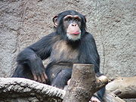
Comparing the classification of Humans and Chimpanzees (page 19)
Level | Human | Chimp
Kingdom → | Animalia | Animalia
Phylum → | Chordata | Chordata
Class → | Mamalia | Mamalia
Order → | Primate | Primate
Family → | Hominidae | Pongidae
Genus → | Homo | Pan
Species → | sapien | troglodytes

Slide 43
Booklet stops here… following slides if time permits
If you’re looking at this outside of class, enjoy the pictures.
If you have questions over the organism names or examples go see Mr. Kapa

Slide 44
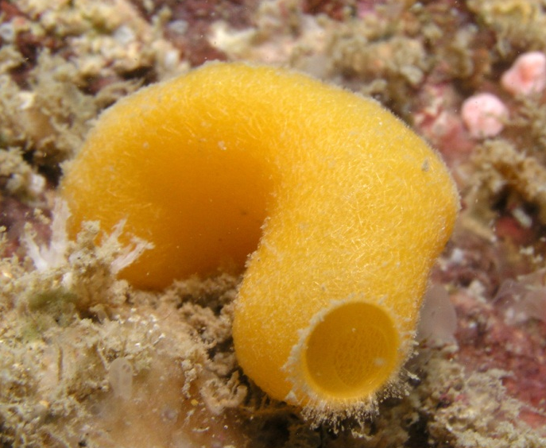
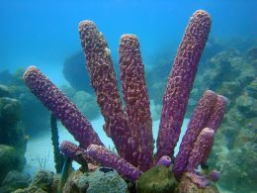
Phylum: Porifera
Sea sponges
Asymmetrical
3 cell layers (no true tissues)
Non-motile or sessile (they don’t move)

Slide 45
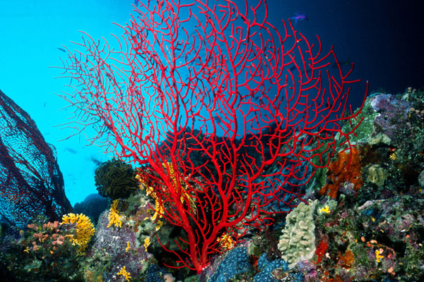
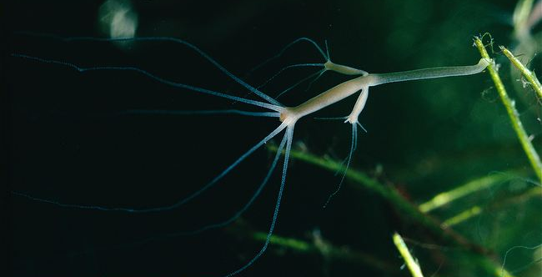
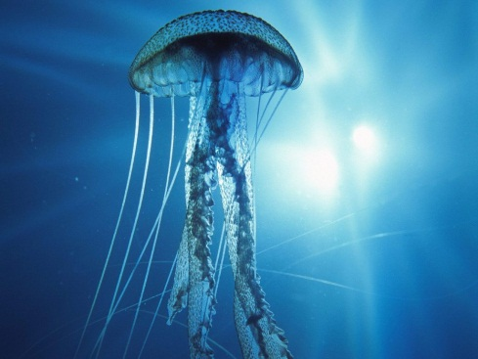
Phylum: Cnidaria
Corals, jellies and hydras
Radially symmetrical
2 cell layers (no true tissues)
Non-motile and motile (some move some don’t)

Slide 46
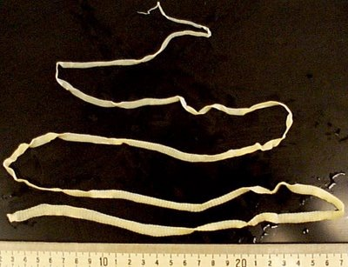
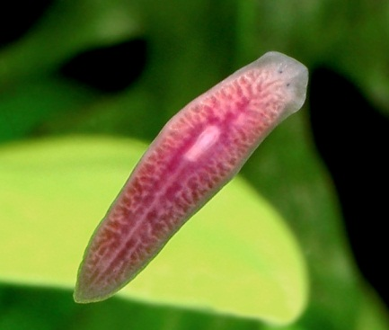
Phylum: Platyhelminthes
Flatworms (tapeworm, planarians, flukes)
Bilateral symmetry
Nervous system
3 tissue layers (include mouth and anus)

Slide 47
Phylum: Nemotoda
Round worms
Found almost everywhere
DO NOT have segmented bodies
Bilateral symmetry
Many are parasites

Slide 48
Phylum: Annelida
Segmented worms (earthworms, leeches, etc)
Have individual body segments (rings)
Bilateral symmetry

Slide 49
Phylum: Mollusca
Snails, slugs, bivalves, octopus, squid, nautilus and cuttlefish (to name a few)
Most aquatic
Soft bodied
Secrete shell (some reduced and internal)

Slide 50
Phylum: Arthropoda
Crabs, lobsters, insects, spiders, scorpions, etc
Have segmented external shell (like a suit of armor)

Slide 51
Phylum: Echinodermata
Starfish, sand dollars, sea urchins, etc
Epidermis covers a exoskeleton layer
Use hydraulic “tube feet” for moving and eating

Slide 52
Phylum: Chordata
Vertebrates (have a backbone)
Everything else up to now has been Invertebrate (did not have a backbone)

Slide 53
Classification of Vertebrates (Page 18) bottom
Agnatha – jawless fish
Chondrichthyes – cartilaginous fish, sharks
Osteichthyes – bony fish
Amphibia
Reptilia
Aves – birds
Mammalia

Slide 54
Order Monotremata
Family Ornithorhynchidae, Duck billed Platypus

Slide 55
Order Monotremata
Family Tachyglossidae, Spiny Anteater

Slide 56
Order Didelphimorphia - Opossums

Slide 57
Order Diprotodontia
(10 families and 117 species) Kangaroos, Wallaby, Wombat, Koalas

Slide 58
Order Artiodactyla
Even-toed ungulates: Antelope, Deer, Camel, Pig, Cow, Sheep, Hippo,

Slide 59
Order Perissodactyla
Odd-toed ungulates: Horses, Rhinos, Tapirs

Slide 60
Order Carnivora
Cats, Bears, Weasels, Dogs

Slide 61
Order Cetacea
Whales, Dolphins

Slide 62
Order Chiroptera
Bats

Slide 63
Order Insectivora
Insect-eaters: Hedgehogs, Moles, Shrews

Slide 64
Order Lagomorpha
Rabbits, Hares

Slide 65
Order Primates
Apes, Monkeys, Lemurs, Humans

Slide 66
Order Proboscidea
Elephants

Slide 67
Order Rodentia
Rodents: Rats, Mice, Squirrels, Gerbils, Hamsters, Capybaras(largest rodents in the world)

Slide 68
Order Sirenia
Sea Cows, Manatees

Slide 69
Order Tubulidentata
Aardvarks

Slide 70
Order Edentata [also called Xenarthra]
Sloths, Armadillos

Slide 71
Order Pholidota
Pangolin

Slide 72
History of Human Kind
Oldest Fossil – 4.4 MYA
Oldest tool use – 2.5 - 3.4 MYA
Earliest Migrations – 1.8 MYA
Oldest Culture – 1.6 MYA
Earliest Language – 50,000 - 100,000 YA
Earliest Art – 40,000 YA
Domesticated Animals – 30,000 YA
Agriculture (farming) – 12,000 - 15,000 YA

Slide 73
Front Cover
Go back to your cover and draw the diagram on the next slide, on the bottom half of your cover page.
This is one of the most current theories as to what the tree of life looks like for the 6 kingdoms showing who evolved from whom.

Slide 74
Hypothetical Tree/Ring of life
Protista
Fungi
Plantae
Animalia
Eukaryotic
Eubacteria
Archaebacteria
Prokaryotic
One or More possible FIRST organisms on EARTH

Slide 75
HumanEvolution
Did Climate Change Drive Human Evolution?
Listen To the Story on NPR

Slide 76
Five fossilized human skulls show how the shape of the early human face evolved: (left to right) Australopithecus africanus, 2.5 million years old; Homo rudolfensis, 1.9 million years old; Homo erectus, 1 million years old; Homo heidelbergensis, 350,000 years old; Homo sapiens, 4,800 years old. Scientists believe that climate change had a major impact on the development of early humans.

Slide 77
Skeletons currently on display at the National Museum of Natural History: (left to right) Homo erectus, 1 million years old; Australopithecus afarensis, 2.5 million years old; Homo neanderthalensis, 32,000 to 100,000 years old. Researchers are using ancient remains like these to learn more about the effects climate change may have had on evolution.

